Slide 1
Docker....is it magic?
Presented by Tim Laurence
To Waterloo DevOps MeetUp
On July 6th, 2016

Slide 2
Who Am I
Unix Systems Administrator
Larger scale
I usually run other people's code....
until recently

Slide 3
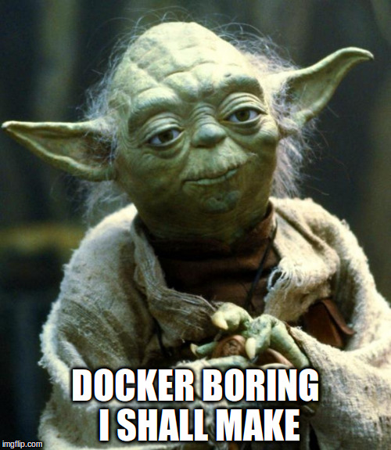
Agenda

Slide 4
History
March 13, 2013 Pope Francis was elected
Oh, and Docker was annouced
July 23, 2013, dotCloud, Inc. announced Docker as the primary focus of the company
September 19, 2013, Red Hat and Docker announced a significant collaboration
January 22, 2014, $15 million Series B venture capital round
September 16, 2014, $40 M Series C round
October 15, 2014, Microsoft announced integration of the Docker engine into the next Windows Server release

Slide 5
Isolating programs
Virtualization
  Same hardware
  Different kernel + os+ pocesses + filesystem + networking + etc
Container
  Same kernel + os
  Different pocesses + filesystem + networking + etc
Docker (container+)
  Container +
  Layered filesystem +
  Very easy to use

Slide 6
Not the first
Not on linux
  Solaris Zones
  BSD-Jails
  AIX WPARS
Linux
  LXC
  OpenVZ

Slide 7
What makes docker tick?
Talk about the technology
Give a simple demo of it in action

Slide 8
capabilities
partitioning of root privilege into a set of assignable privileges
CAP_DAC_OVERRIDE
CAP_NET_ADMIN
CAP_NET_BIND_SERVICE
And many more….

Slide 9
control groups/cgroups
Control and manage resources such as memory, cpu, networking
Limit usage
Set priorities
Audit usage

Slide 10
namespaces
Provide an isolation for a set of processes
Process outside of a namespace can see the contents of the child namespace
Namespaces can't see their parents

Slide 11
More about namespaces
PID namespace
  Limits what PIDs are visible
net namespace
  Independent list of interfaces and IPs
  Separate routing table
  Separate iptables
IPC – Interprocess Communication
mnt - /proc/mounts vs mount
  Separate view of the filesystem
uts – hostname
  Separate hostname
user
  Separated list of users

Slide 12
another unionfs/aufs
Combines multiple file systems (or directory trees) into one
Layering
Copy-on-write/COW
White-Out

Slide 13
Review what we have
We can control and assign special privileges to processes
We can restrict resources a process can use
We can hide information from processes
We can enable fine grained limits to permit processes to share parts of a system
We can sandbox filesystems changes that processes may make

Slide 14
Virtual Machines
Your
App
Your
App
Your
App
Kernel
+ OS
Kernel +OS
Containers
Virtual
HW
Virtual
HardWare
Your
App
Your
App
Your
App
Your
App
Hypervisor/Application
File-
System
File-
System
File-System
OS + Kernel
OS + Kernel
Hardware
Hardware

Slide 15
Virtual Machines
Your
App
Your
App
Your
App
Kernel
+ OS
Kernel +OS
Docker Containers
Containers
Your
App
Your
App
Your
App
Virtual
HW
Virtual
HardWare
Your
App
Your
App
Your
App
Your
App
RW FS
RW FS
RW FS
Hypervisor/Application
File-
System
File-
System
File-System
RO
FS
Image
RO
FS
Image
OS + Kernel
OS + Kernel
OS + Kernel
Hardware
Hardware
Hardware

Slide 16
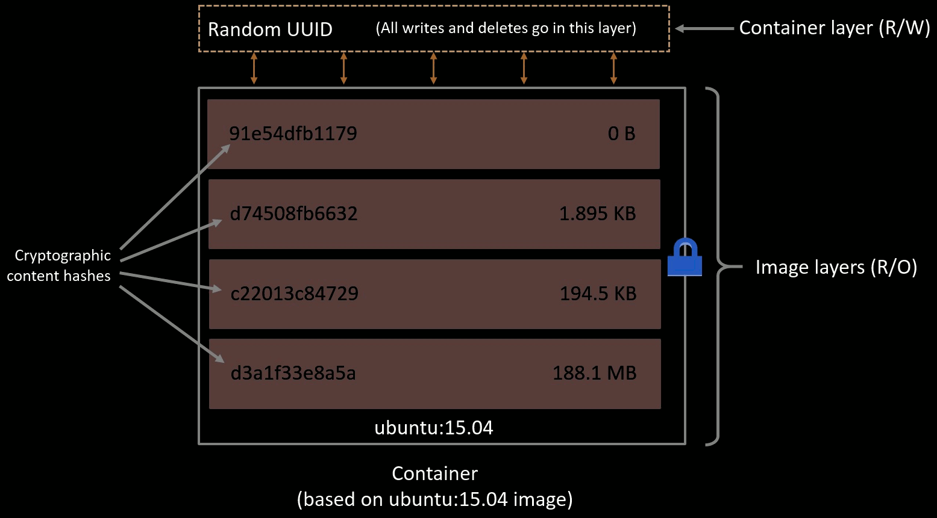
https://docs.docker.com/engine/userguide/storagedriver/imagesandcontainers/

Slide 17
Terms
Image
A description of a series of layers +
those layers
Container
A RW layer placed on top of a "Image" +
meta-data
Image == Class
Container == Instance

Slide 18
Docker.....Finally
Application-centric.
  Focused on the deployment of applications/services
Portable deployment
  Bundling an application and all its dependencies
Automatic build
  Tools to automatically assemble an image
Component re-use
  Any image can be used as a "base image" to create more specialized images.
Sharing
  Docker has access to a public registry
Tool ecosystem
  Docker defines an API for automating and customizing the creation and deployment of containers.

Slide 19
Why the excitement?
It's fast!
It's really fast!
No seriously, it's fast!
Cheap on memory and disk
Easy to build reusable components from other reusable components

Slide 20
Docker running
Pulls image: Check for presence of image and download if missing
Create a new container: Use image to create a container.
Allocates a filesystem and mounts a read-write layer: The container is created in the file system and a read-write layer is added to the image.
Allocates a network / bridge interface.
Sets up an IP address: Attaches IP address from a pool.
Executes a process that you specify.
Captures application output:

Slide 21
Want More?
Docker Doc
https://docs.docker.com
Check out tutorial and compose
Me
TimDaMan@gmail.com
https://www.linkedin.com/in/timlaurence
eSentire is hiring
https://www.esentire.com/about-us/careers/

